Slide 1
Resource Management
Setup Document

Slide 2
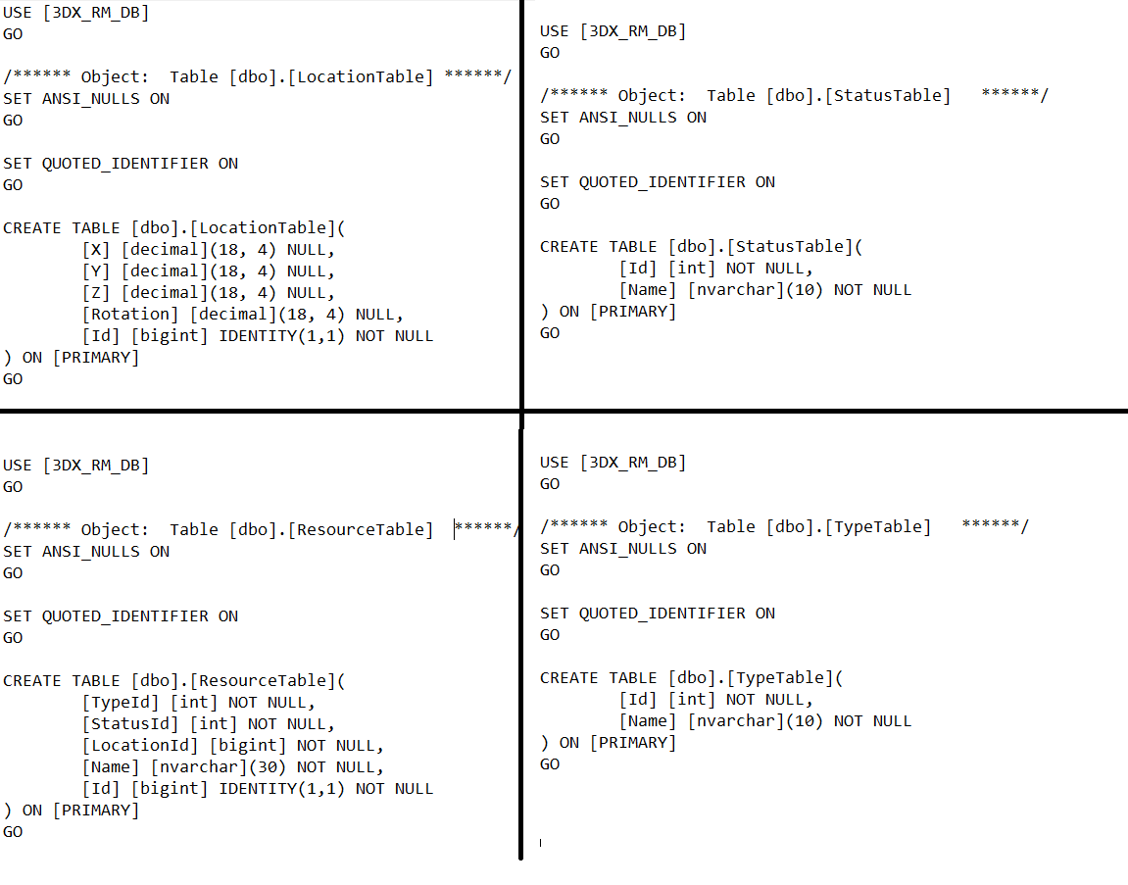
Create Database
Create Database with Name [3DX_RM_DB]
Create Tables (LocationTable,ResourceTable,StatusTable,TypeTable) by using below command

Slide 3
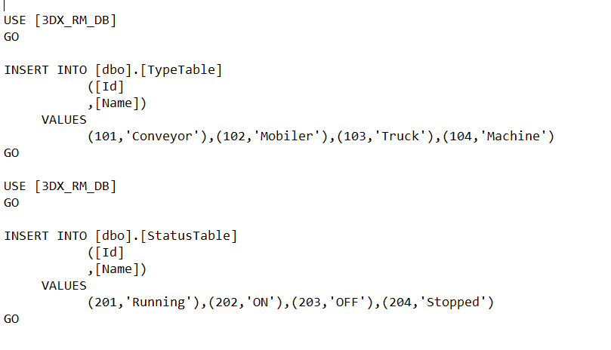
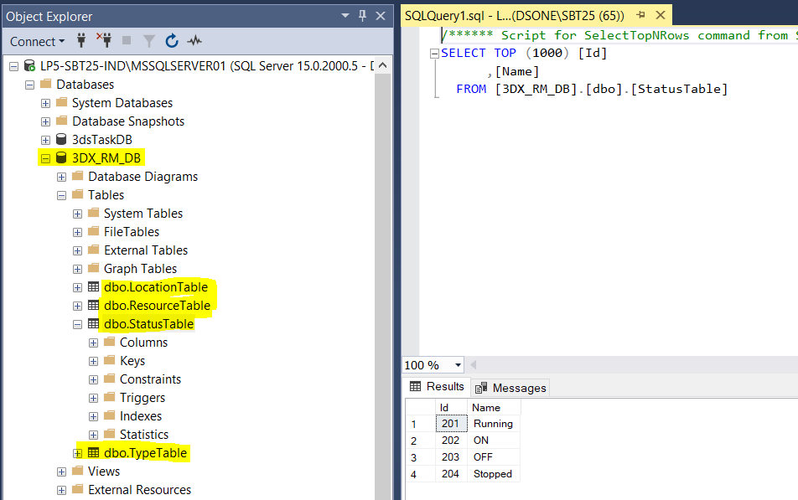
3) Insert values to Statustable , Typetable using below commands

Slide 4
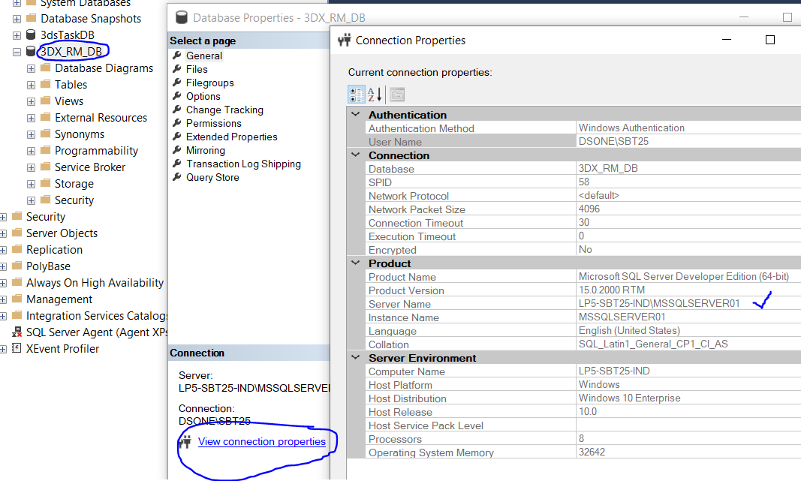
RM_API
Steps to be followed to setup Resource Management Api App:-
We have to update the DB connection string which is residing in Global.asx file
Open SSMS, right click on the database, go to database property, then go to connection properties, copy the server name and replace it in the initial string of the connection string mentioned in Global.asx file.

Slide 5
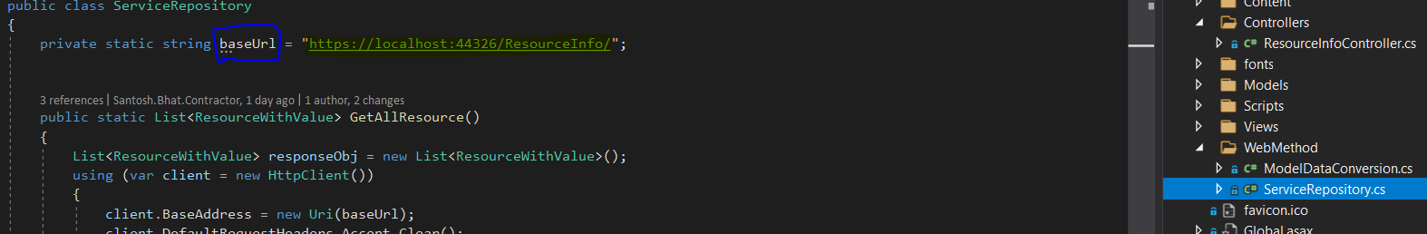
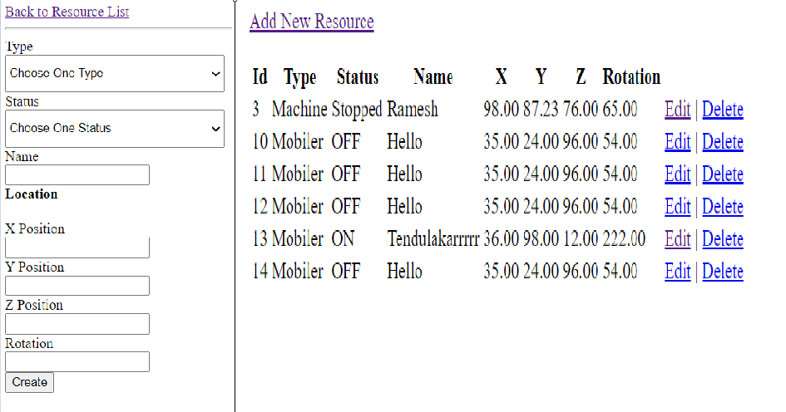
RM client App
If there is any changes in RM_API host url address, you can update baseUrl of WebMethod.ServiceRepository
2. Run the application with address https://localhost:[port]/ResourceInfo/AddResource
You get add resource , edit , delete options

Slide 6
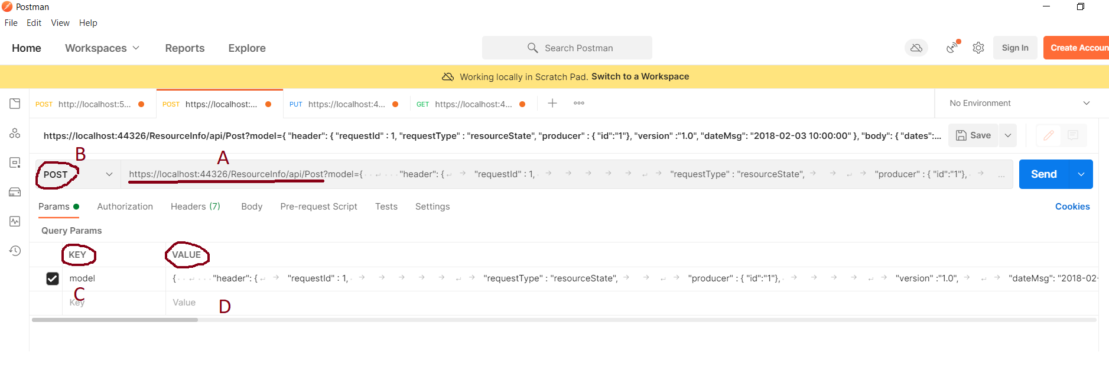
3) PostMan service call methods
A ] Provide the calling method Url in the given textbox
B ] Check the respective Http Method
C ] Provide the params key : name as the parameter in the method
D ] Provide the params value : as per the Json request format

Slide 7
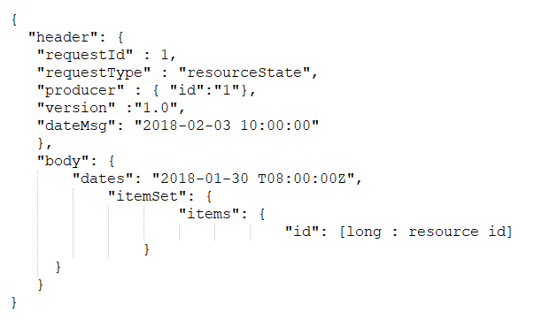
4) GetResource Request JSON Format :-
a) URL :- https://localhost:44326/ResourceInfo/api/Get
b) Method :- GET
c) params Key :- model
d) params Value :-

Slide 8
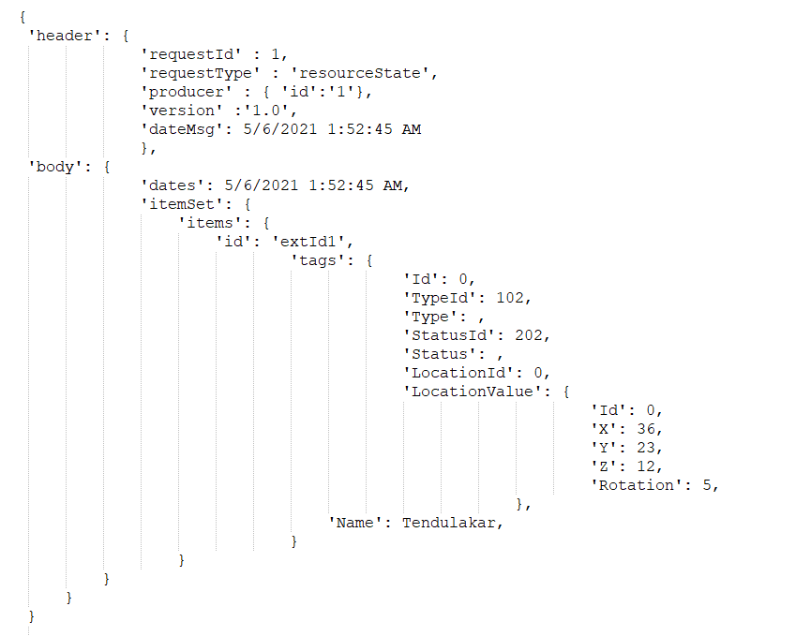
5) PostResource Json Request Format:
a) URL :- https://localhost:44326/ResourceInfo/api/Post
b) Method :- POST
c) params Key :- model
d) params Value :-

Slide 9
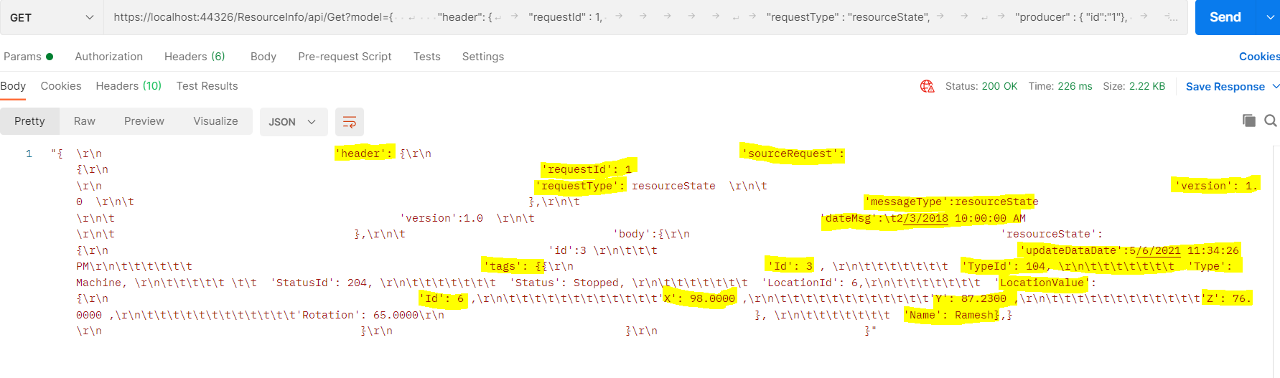
6) GetResource Response:

Slide 10
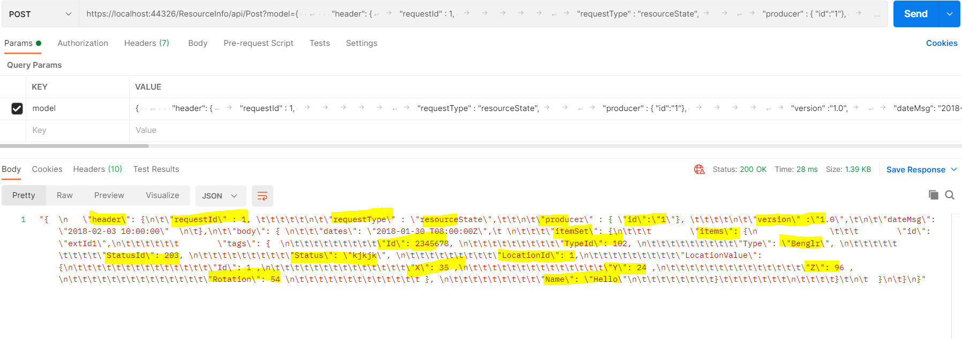
8) PostResource Response :

Slide 11
Postman : Get Resource String
{
"header": {
"requestId" : 1,
"requestType" : "resourceState",
"producer" : { "id":"1"},
"version" :"1.0",
"dateMsg": "2018-02-03 10:00:00"
},
"body": {
"dates": "2018-01-30 T08:00:00Z",
"itemSet": {
"items": {
"id": [long : resource id]
}
}
}
}

Slide 12
Postman : Post Resource String
{
'header': {
'sourceRequest': {
'requestId': 1
'requestType': resourceState
'version': 1.0
},
'messageType':resourceState
'version':1.0
'dateMsg': 2/3/2018 10:00:00 AM
},
'body':{
'resourceState': {
'id':extId1
'updateDataDate':5/5/2021 5:11:21 PM

Slide 13
'tags': {
'Id': 2345678 ,
'TypeId': 102,
'Type': Benglr,
'StatusId': 203,
'Status': kjkjk,
'LocationId': 1,
'LocationValue': {
'Id': 1 ,
'X': 35 ,
'Y': 24 ,
'Z': 96 ,
'Rotation': 54
},
'Name': Hello
}
}
}
}

